Slide 1
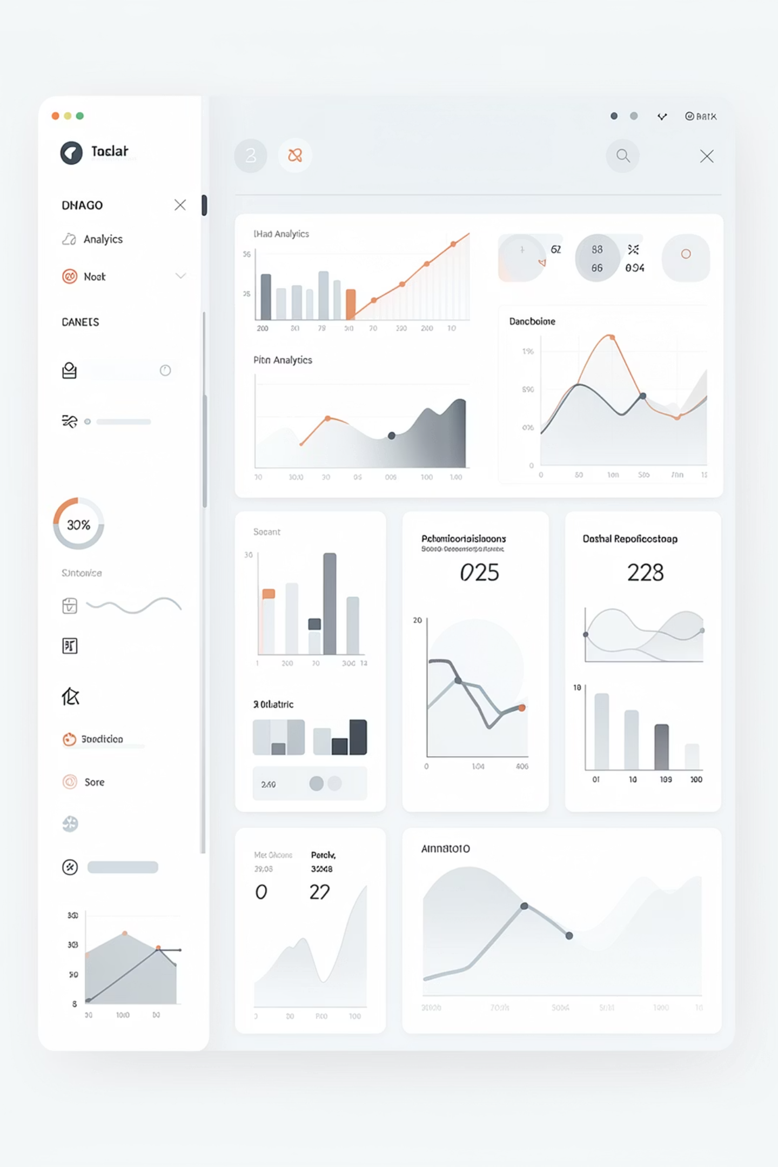


Customer Purchase
Behavior Analysis Using Excel Dashboard
Presented by: Partistha Singhmar (UID: 24BCA10301)
Course: Bachelor of Computer Applications (BCA) | University: Chandigarh University

Slide 2

Introduction
Data-Driven Decisions
Customer Insights
Modern businesses rely on data analysis to make strategic decisions
Organizations analyze customer data to understand buying behavior patterns
Excel Power
Purchase Patterns
Microsoft Excel provides powerful tools for data analysis and visualization
This project focuses on analyzing customer purchase patterns and trends

Slide 3
Problem Statement
Unstructured Data
Pattern Recognition
Data Quality Issues
Raw datasets are unstructured and complex, making them difficult to work with
Identifying patterns and trends without proper visualization is challenging
Presence of duplicate entries and inconsistent data formats
Lack of Insights
Conversion Needed
Raw data provides limited meaningful insights without processing
Need to convert raw data into an understandable format for analysis

Slide 4
Project Objectives
01
02
03
Data Cleaning
Data Standardization
Pivot Table Analysis
Clean and preprocess raw customer data
Standardize and organize the dataset
Analyze data using Pivot Tables
04
05
Visualization Creation
Interactive Dashboard
Create meaningful visualizations
Design an interactive dashboard using slicers

Slide 5
Dataset Overview
Dataset contains customer information used to analyze purchase behavior
Gender
Marital Status
Male or Female classification
Single or Married status
Income
Age
Annual income levels
Customer age groups
Education
Occupation
Educational background
Job and career details
Commute Distance
Region
Distance to workplace
Geographic location

Slide 6





Data Preprocessing
Steps taken to prepare and clean the dataset
Working Sheet
Created working sheet from original dataset
Remove Duplicates
Removed duplicate entries
Value Replacement
Replaced M→Male, F→Female, S→Single
Currency Format
Converted income to currency format
Age Brackets
Created age brackets: Adolescent, Middle Age, Old

Slide 7
Tools & Techniques
Microsoft Excel
Pivot Tables
Primary tool for data analysis
Data analysis tool for summarizing information
Charts
Slicers
Bar, Line, and Column charts for visualization
Interactive filtering for data exploration
Dashboard
Report Connections
Central hub for visualizations
Linking filters across multiple reports

Slide 8

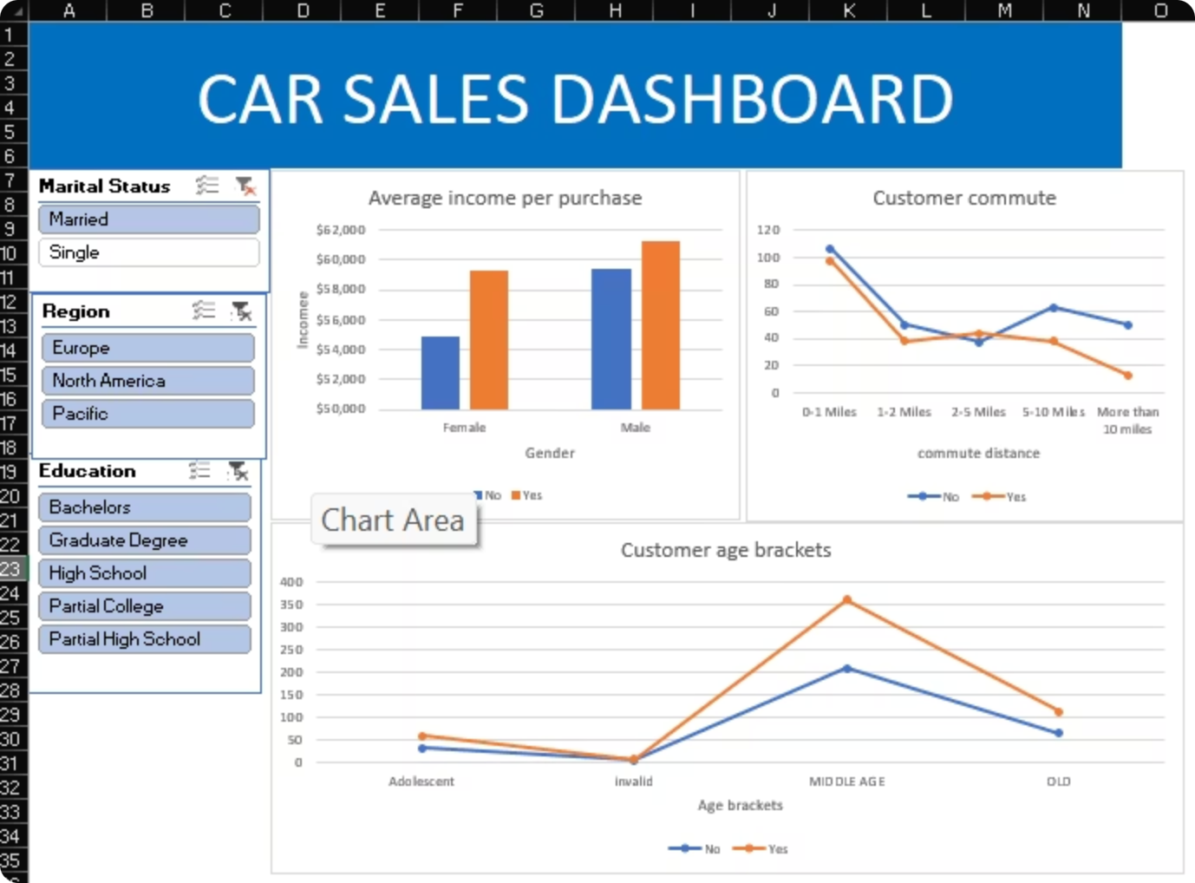
Dashboard
The dashboard displays key insights visually with interactive filtering capabilities
Visual Displays
Interactive Slicers
Average income per purchase
Customer commute trends
Age bracket distribution
Marital Status filter
Region filter
Education filter

Slide 9
Key Insights
1
2
3
Income Correlation
Age Impact
Commute Influence
Customers with higher income tend to purchase more frequently
Middle-aged group shows highest purchasing behavior
Commute distance influences buying patterns and preferences
4
5
Dynamic Filtering
Improved Decision-Making
Dashboard allows dynamic filtering across multiple dimensions
Interactive analysis improves decision-making processes

Slide 10
Conclusion & Future Scope
Conclusion
Future Scope
Excel is effective for data analysis and visualization
Use Power BI for advanced dashboards
Dashboard simplifies complex data interpretation
Apply machine learning for prediction
Helps in understanding customer behavior patterns
Automate analysis using Python

Slide 11
THANK YOU!

